Slide 1

INSIGHTS OF ONLINE RETAIL STORE
-ADITYA PANDEY

Slide 2
TOPICS
1
2
3
4
5
Introduction
Workflow
Data Processing
Visualizations&
Insights
Suggestions
&
Strategies

Slide 3

Introduction
This presentation helps us to understand the trends and analytics of online retail store . It also showcase visualization of dataset of store for easy understanding.

Slide 4
WORKFLOW
STEP 1
Gathering the data from source
STEP 3
Understanding the requirements of CEO & CMO
STEP 5
Insights and Strategies
STEP 2
Data Cleaning and preprocessing
STEP 4
Building the visuals

Slide 5
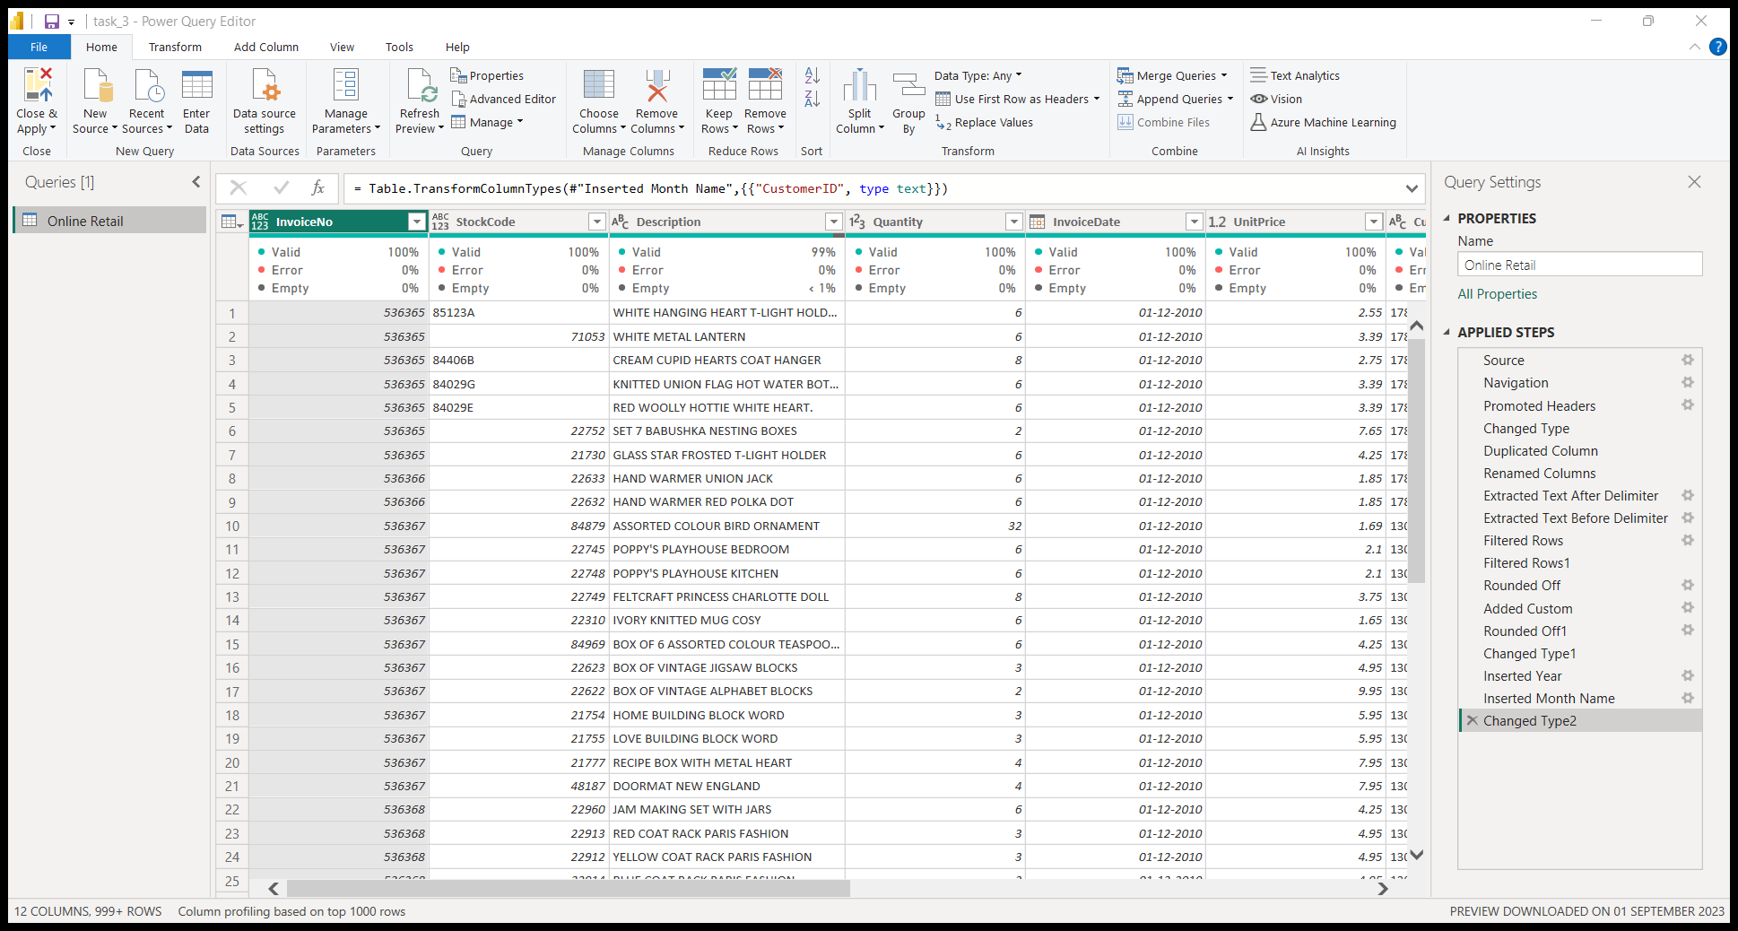
Power Query Editor

Slide 6

The CEO of the retail store is interested to view the time series of the revenue data for the year 2011 only. He would like to view granular data by looking into revenue for each month. The CEO is interested in viewing the seasonal trends and wants to dig deeper into why these trends occur. This analysis will be helpful for the CEO to forecast for the next year.
INSIGHTS
Revenue increased about 50%-60% Between Jul and Nov.
Revenue is lowest in February and April.

Slide 7
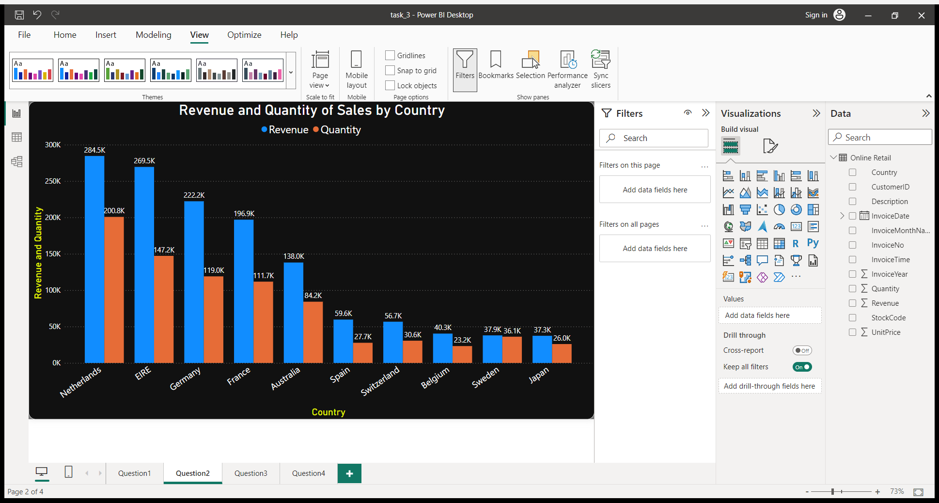

The CMO is interested in viewing the top 10 countries which are generating the highest revenue. Additionally, the CMO is also interested in viewing the quantity sold along with the revenue generated. The CMO does not want to have the United Kingdom in this visual.
Netherlands have highest revenue and Sales.
Top 4 countries in revenue and Sales are from Europe.

Slide 8
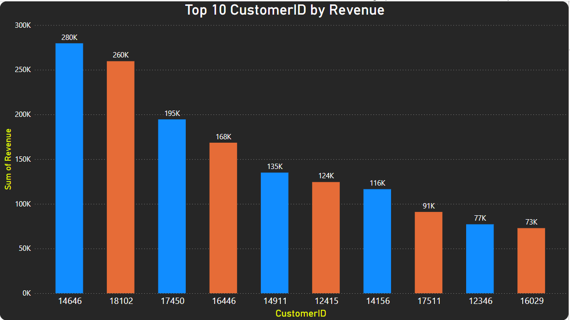
The CMO of the online retail store wants to view the information on the top 10 customers by revenue. He is interested in a visual that shows the greatest revenue generating customer at the start and gradually declines to the lower revenue generating customers. The CMO wants to target the higher revenue generating customers and ensure that they remain satisfied with their products.
Top revenue generating customers are from Australia and Europe.

Slide 9
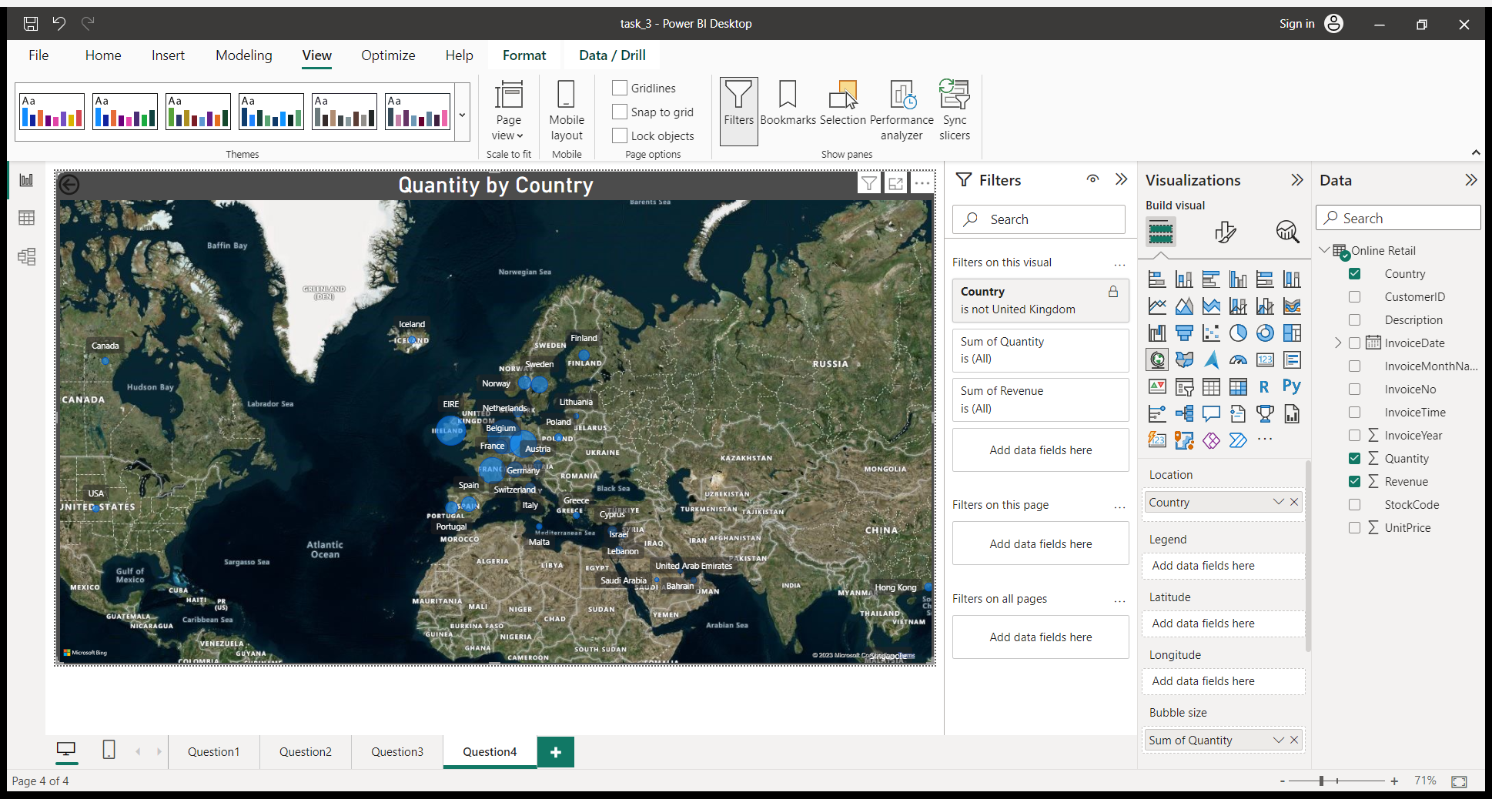
The CEO is looking to gain insights on the demand for their products. He wants to look at all countries and see which regions have the greatest demand for their products. Once the CEO gets an idea of the regions that have high demand, he will initiate an expansion strategy which will allow the company to target these areas and generate more business from these regions. He wants to view the entire data on a single view without the need to scroll or hover over the data points to identify the demand. There is no need to show data for the United Kingdom as the CEO is more interested in viewing the countries that have expansion opportunities.
Netherlands have highest sales of products.
Size of bubble is directly proportional to sales of products.

Slide 10

Thank you

